Slide 1
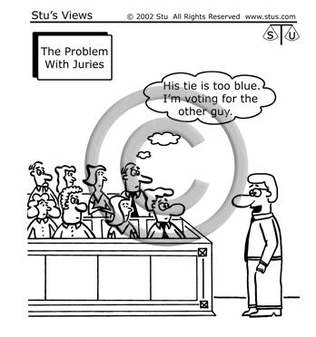
BELL RINGER
POLITICAL CARTOON
What do you see in this political cartoon?
What do you think that it means?

Slide 2
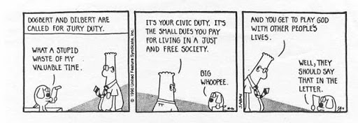
BELL RINGER
POLITICAL CARTOON
1) What do you see in the cartoon?
2) What do you think it means about jury duty?

Slide 3
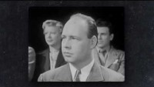
BELL RINGER
Type into the chat:
WHY IS JURY DUTY IMPORTANT?

Slide 4
BELL RINGER
KEY TERMS
Jury of their peers in court means “equals” – a group that represents the population.
Impartiality means “with no prejudice” or “free of bias.”
Unbiased means objective or neutral; not favoring one side or the other.
Fairness means following due process (all the steps and procedures that must be taken).

Slide 5
BELL RINGER
IN GROUPS…
Why does a jury have to be impartial, unbiased, and fair? What would happen if they weren’t? Create an example.
Do you think our juries during the mock trials were impartial, unbiased, and fair? Why or why not?

Slide 6
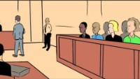
BELL RINGER
Type into the chat:
WHAT ARE SOME WAYS THAT A JUROR CAN BE IMPARTIAL?

Slide 7
BELL RINGER
CONSTITUTIONAL BASIS FOR JURIES AND TRIALS
4th Amendment:
No searches and seizures without a warrant → fairness
5th Amendment:
Due process under the law → fairness & impartial judges
6th Amendment:
Trial by jury → unbiased and impartial
14th Amendment:
Applies all of this to the states

Slide 8
BELL RINGER
PROJECT
Jury Duty Interviews
Find an adult who has been on jury duty before and ask them the 5 interview questions about their experiences.
Then write an “essay” (1-2 long paragraphs) discussing their experiences and why jury duty is such an important element of citizenship.
You may work together with a partner on this project, if you choose!
DUE: Friday, February 19th

